Slide 1

Docker for Databases
Slides and code at scottsauber.com
scottsauber

Slide 2

Audience
People completely new to Docker
Developers/DBAs not sure how Docker fits in with databases
scottsauber
Notes:
Just to level set expectations and some assumptions I had when I made this talk. I had a very particular audience in mind, so hopefully this is lines up with you, so that you can get the most out of this session. This talk targets existing .NET Core Developers who are familiar with the .NET Core/ASP.NET Core ecosystem and need to run a background task, but are maybe unsure of their options and which one to choose. Or maybe they know all the options but aren’t quite sure when you should use which one. Those are all things we are going to talk about today and get those questions answered.

Slide 3
Agenda
What is Docker?
Why Docker?
How does it work?
Demo
Docker + Databases = 😍
scottsauber

Slide 4
Goals
Understand what Docker is
Understand when to use and when not to use Docker with your DB
scottsauber

Slide 5

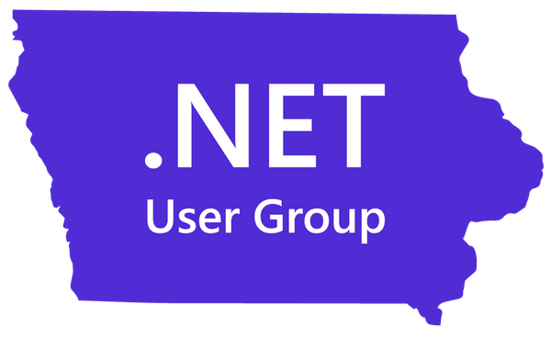
Who am I?
Director of Engineering at Lean TECHniques
Co-organizer of Iowa .NET User Group
Friend of Redgate
Built pipelines for dozens of databases
Blog at scottsauber.com
scottsauber

Slide 6
What is Docker?
Tools to allow you to run applications in an isolated environment called containers (agnostic to Docker)
Backed by Docker Inc.
Synonymous with containers, like Kleenex
scottsauber

Slide 7
What is an image?
Immutable file with instructions for how to create a container
Made up of layers
Starts with an OS
Install any software
scottsauber

Slide 8
What is a container?
Runnable instance of an image
Liked a self-contained VM
Isolated from other containers
Can run multiple containers from the same image (i.e. multiple 2019 MSSQL containers)
Or from other images (i.e. 2019 MSSQL, 2017 MSSQL, etc)
scottsauber

Slide 9
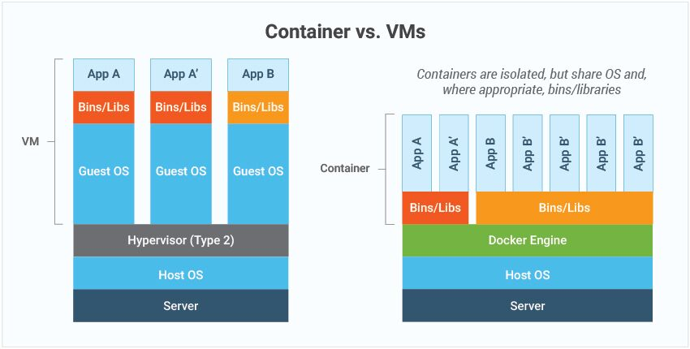
Containers vs Virtual Machines
scottsauber

Slide 10
Why Containers?
“Works on my machine”
Isolated from each other and host machine
Repeatable
Fast to spin up
Easy to tear down
Multiple instances and versions
scottsauber

Slide 11
Container Registry
Sharing images
Images tagged with versions (i.e. MSSQL 2022, 2019, specific CUs, etc)
Docker Hub is public example
Can have an internal one just for your company
Like NuGet or npm for sharing code but for Docker
scottsauber

Slide 12
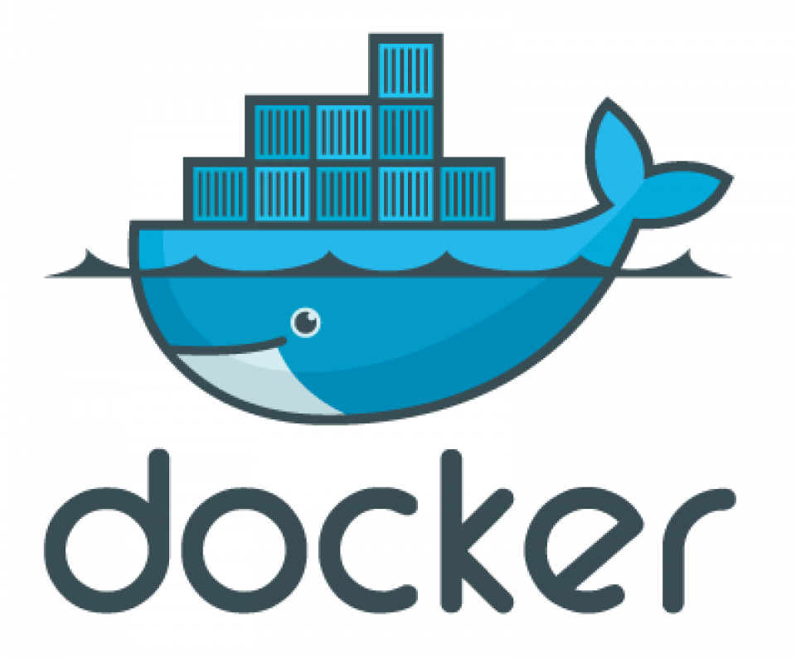
Demo
Notes:
Docker Hub
docker pull
docker image ls
docker run
docker run -p
docker container ls
docker container ls –a
Docker run again
docker container ls
Docker stop
Docker-compose.yml

Slide 13
DevOps Challenges With Databases
Development
CI
Isolated from other team members
Applying migrations
Version matching
scottsauber

Slide 14
Which of these does Docker solve?
Development
CI
Isolated from other team members
Applying migrations
Version matching
scottsauber

Slide 15
Which of these does Docker solve?
Development ✅
CI ✅
Isolated from other team members ✅
Applying migrations ✅
Version matching ✅
scottsauber

Slide 16
When do I NOT Docker my DB?
Non-local/CI environments
Definitely not for Production
Prefer PaaS over IaaS
scottsauber

Slide 17
Docker Adoption Progression
Start using Docker with local dev
Start use Docker in CI for tests
Start publishing Docker images with your schema
Start including common datasets with your schema
Consider thinking about backing up Production nightly and publishing a Docker image with the schema and data (after sanitizing)
scottsauber

Slide 18
Takeaways
Overview of what Docker is
Where Docker fits (Local + CI) and where it doesn’t (Production)
scottsauber

Slide 19
Questions? Contact: ssauber@leantechniques.com
Slides and code at scottsauber.com
scottsauber

Slide 20
Thanks!
Slides and code at scottsauber.com
scottsauber

